Slide 1
Group 4 Good Eats
Presented by:
Alexandra Williams, Andrew Winkelman, Michelle Ewers, and Rubina Shrivastava

Slide 2
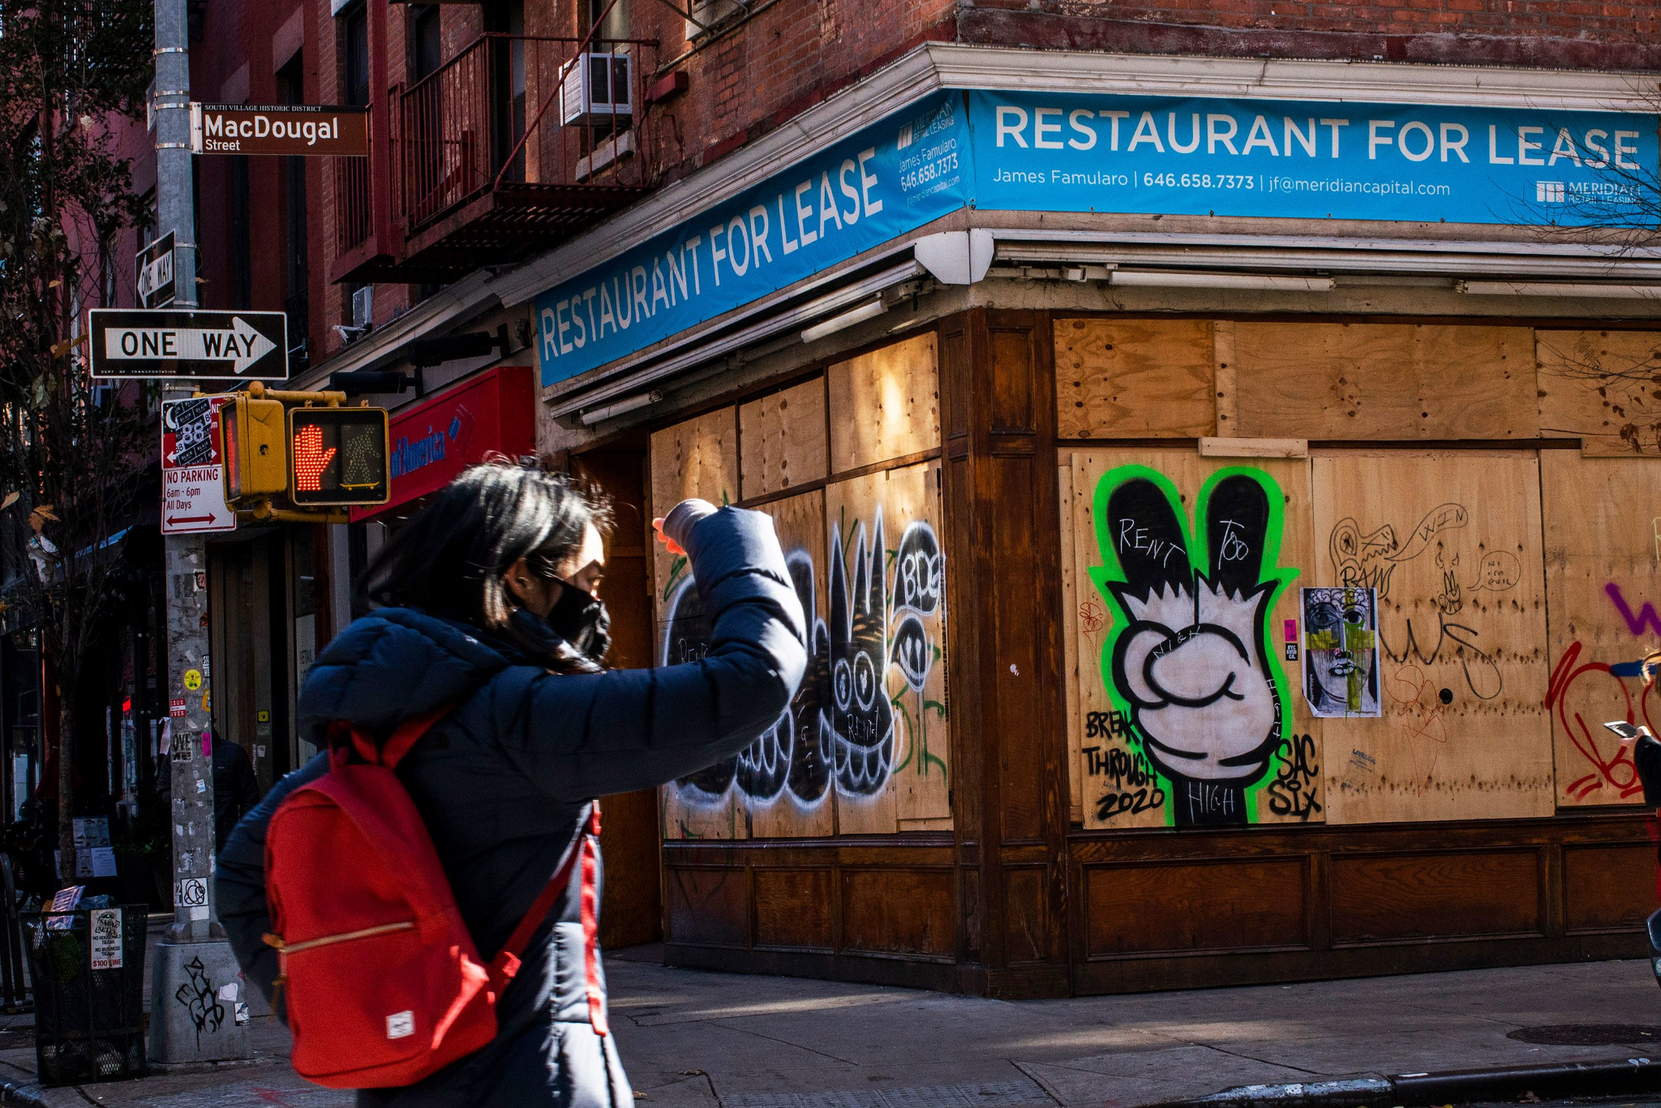

Why this topic?
Restaurant business is difficult industry
Familiarity of utilizing reviews before buying products or trying new restaurants
This Machine Learning Model can serve as a prototype to sell in different markets to evaluate competition
This analysis looks at several variables
Price Point
# of Reviews
Comparable restaurants to measure a gap to be filled?
Neighborhoods

Slide 3
Will our Restaurant be successful in San Francisco?
Would our Thai-Indian Fusion Restaurant be Successful in San Francisco?
Yes!
Model predicts 94.9% success
Popular Area with proven success with both cuisines
Fills void of high end dining option in area and market as a whole
Price- $$$
Neighborhood- Sunset District

Slide 4
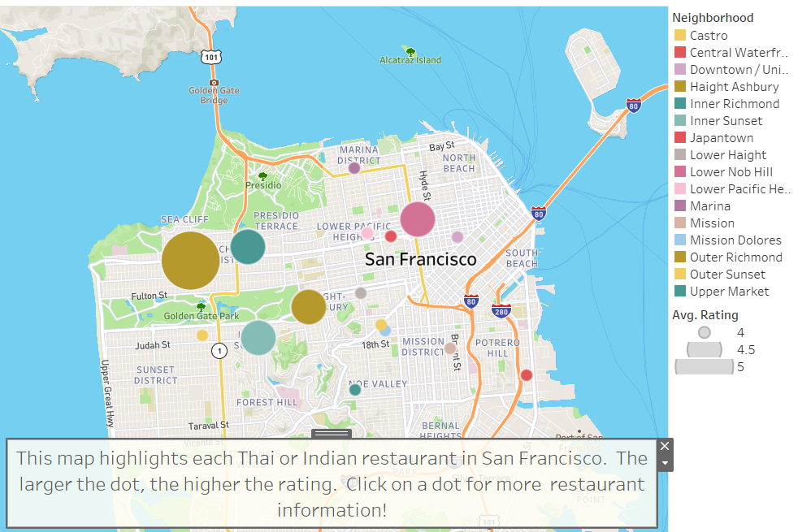
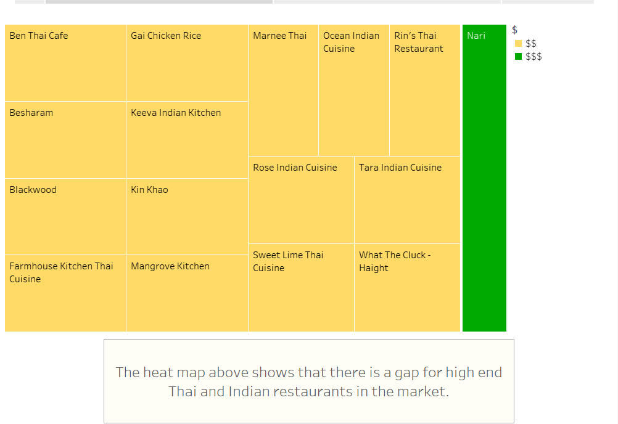
Data Analysis

Slide 5
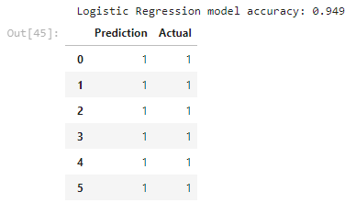
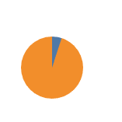
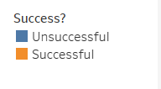
Machine Learning Results

Slide 6
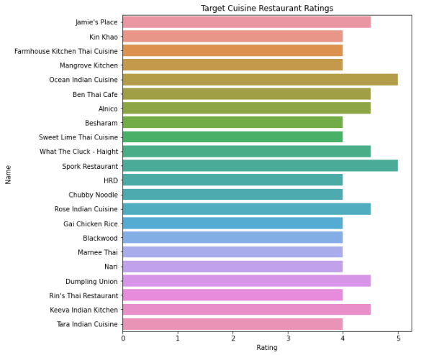
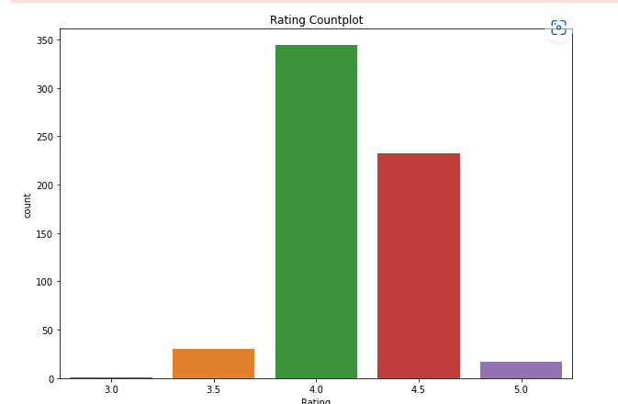
Data Exploration
What factors play a role in a successful restaurant?
Is there a relationship between number of cuisines, number of competitors, price that make a restaurant successful?
Does the number of reviews for a restaurant dictate success or failure?

Slide 7
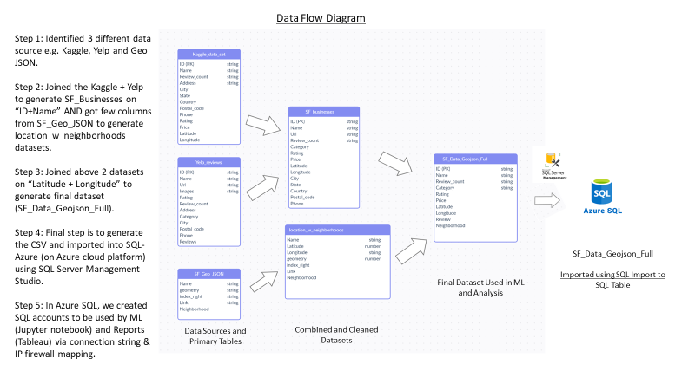
Data Integration

Slide 8
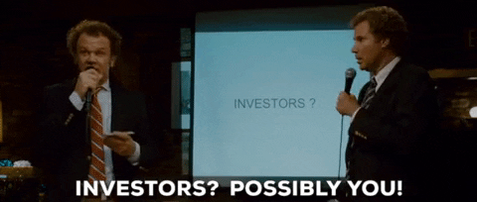
Future Analysis
Explore different markets to help predict successful restaurant launches
Aid Restaurateur investors decision making for high level market analysis
Assist in other service industries that rely on Google, Yelp, BBB reviews
Good Eats Group 4 | Tableau Public

